Slide 1
KV4001 Week 3
Inheritance (Basics)
A key OOP concept

Slide 2
Introduction
Object oriented languages have a feature called inheritance.
Inheritance enables you to define a new class based upon an existing class.
the new class is similar to the existing class,
but has additional member variables and methods.
This makes programming easier because you can build upon an existing class instead of starting out from scratch.

Slide 3
Introduction continued
For example, graphical user interface programming is done by using inheritance:
the basic graphical classes that are contained in a standard library.
the classes needed for a particular application are created by customizing these basic classes.

Slide 4
Question
Give two reasons why, instead of creating new classes from old classes by inheritance, you couldn't just copy the source code for the old class and modify it so that it does exactly what you want?

Slide 5
Possible Answer

Slide 6
Possible Answer

Slide 7
Single Inheritance
The class that is used to define a new class is called a parent class (or superclass or base class.)
The class based on the parent class is called a child class (or subclass or derived class.)
In Java children inherit characteristics from just one parent.
ParentClass
ChildClass

Slide 8
Questions
In Java can a superclass class have more than one subclass class?
Can a superclass class inherit characteristics from its subclass class?

Slide 9
Java Syntax for Inheritance
Simple notation:
public class subClass extends superClass
{
// new characteristics of the subClass go here
}
the subclass extends the superclass

Slide 10
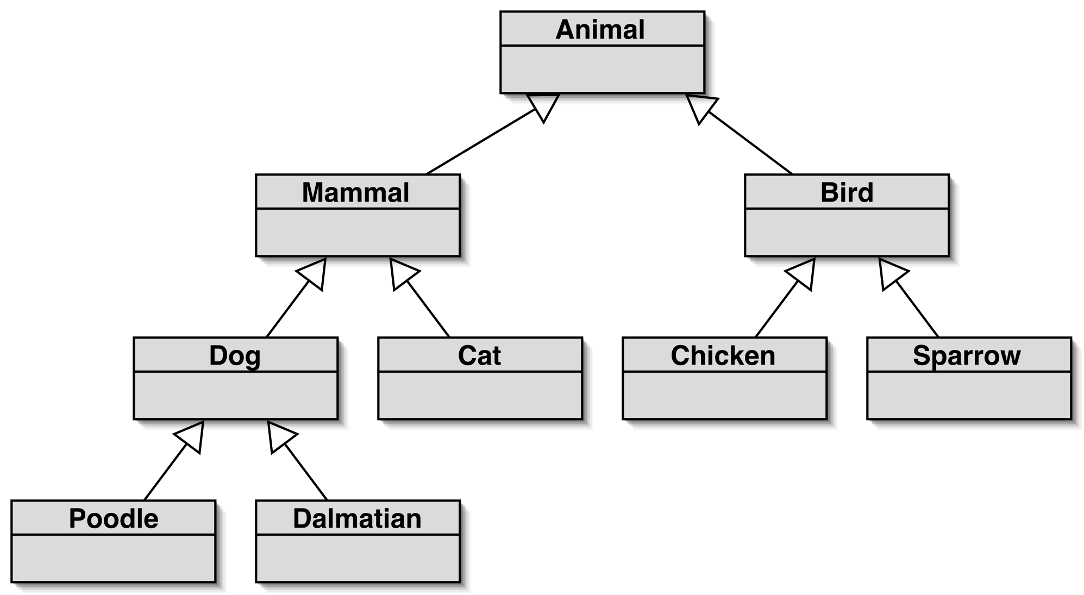
Inheritance hierarchies
A class may be the superclass for a subclass class and may be a superclass of another class.
Note UML notation for inheritance

Slide 11
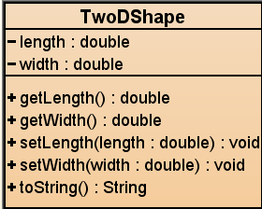
First Example
Consider the following class:
Code on Blackboard
Create a new project.
Add TwoDShape to project.
Compile and test it.

Slide 12
public class Rectangle extends TwoDShape
{
private String style;
public double area()
{
return getWidth() * getLength();
}
public void setStyle(String style)
{
this.style = style;
}
public String getStyle()
{
return style;
}
}
Example (continued)
A subclass that extends TwoDShape:

Slide 13
Accessing attributes in superclass
Rectangle extends TwoDShape.
Attributes declared private are only visible to objects of that class.
Same rules apply with inheritance.
Accessing attributes in superclass class:
since they are private must use accessor methods. e.g.
public double area()
{
return getWidth() * getLength();
}
do not qualify method names
NOT twoDShapeObjectName.getWidth()
Both defined in TwoDShape.
Both declared public.

Slide 14
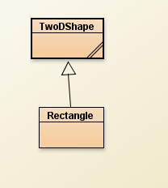
Exercise 1
Add Rectangle to your project.
Compile it.
Create a Rectangle object.
Right click on your Rectangle object.
(see next slide)

Slide 15
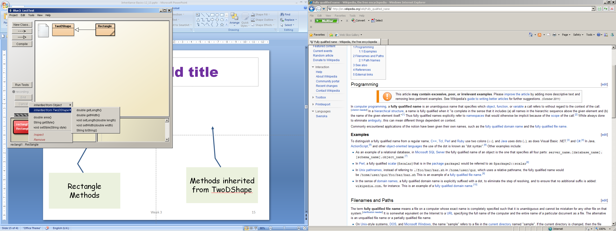
Methods inherited from TwoDShape
Rectangle Methods

Slide 16
Exercise 2
Using the mutator methods, set the attributes for your Rectangle object as:
width = 4.0
length = 3.0
style = “rectangle”
Examine your rectangle object to make sure the methods worked.

Slide 17
Some Notes
TwoDShape is a generic class for two dimensional shapes.
Rectangle includes all the public parts of TwoDShape.
TwoDShape can be used in its own right.

Slide 18
Constructors and Inheritance
Possible for both superclass and subclass to have their own constructors.
Which is used?
superclass?
subclass?
both?
Answer?

Slide 19
Constructors and Inheritance continued
Previous example used default constructors (as none were written).
Now example still using the default constructor for TwoDShape and the following constructor for Rectangle.
public Rectangle( String style,
double width, double length)
{
setWidth(width);
setLength(length);
this.style = style;
}
Defined in TwoDShape
Add to Rectangle
Test to ensure works

Slide 20
Constructors and Inheritance continued
What if the superClass has a parameterised constructor:
public TwoDShape(double width, double length)
{
this.width = width;
this. length = length;
}
Add the constructor to TwoDShape
Compile TwoDShape – Should compile clean.
Compile Rectangle
What happens?
Why?
Now superclass constructor initializes length & width when object is created.

Slide 21
Constructors and Inheritance continued
constructor TwoDShape in class TwoDShape cannot be applied to given types:
required: double, double; found: no arguments; reason: actual and formal argument lists differ in length
Rectangle uses TwoDShape mutators. It does not pass the values to the TwoDShape constructor (found: no arguments).
Need to introduce a call super in subClass to access superclass constructor. e.g.
super ( [superclassParameterList] ) ;
public TwoDShape(double width, double length)
{
this.width = width;
this.length = length;
}
public Rectangle(String style, double width, double length)
{
setWidth(width);
setLength(length);
this.style = style;
}

Slide 22
Constructors and Inheritance continued
We now write the Rectangle constructor as:
public Rectangle( String style,
double width, double length)
{
super( width, length);
this.style = style;
}
Pass superClass values to superClass constructor.
Modify the constructor in Rectangle.
Test.

Slide 23
Rules for Using super
Must be the first call in the subclass constructor.
The parameter pattern must match one of the superclass constructors.
If the superclass has a parameterised constructor you should also provide it a no-arg constructor.
super() always refers to the immediate superclass class.

Slide 24
Exercise 3
A square has two equal sides.
Modify TwoDShape so that it has a no-arg constructor.
Modify TwoDShape so that it has a third constructor that has just one double parameter that is used to set both the width and breadth.
Modify Rectangle so that it has a constructor for a square.
public TwoDShape()
{ }

Slide 25
Exercise 3 Answer

Slide 26
Example: Database of CDs and DVDs
Based on the example by Barnes and Kolling
Functionality
enter data:
CD: title, artist, # tracks, playing time, got-it, comment
DVD: title, director, playing time, got-it, comment
print lists

Slide 27
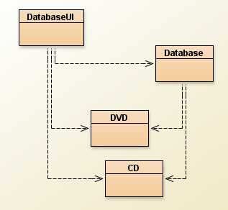
Initial System

Slide 28
Exercise 4
Create a new BlueJ project called DomeV1
The following classes are available on Blackboard:
CD
DVD
Database
DatabaseUI
Add them to your project
Make sure you understand them

Slide 29
Specification Database
Class: Database
accessors:
list
Lists all the entries in the database
mutators:
addCD
Adds a CD to the database
addDVD
Adds a DVD to the database

Slide 30
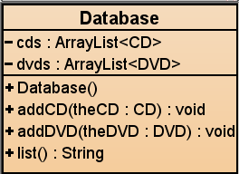
The Database Class
Key question:
How to store the collections of CDs and DVDs?
Considerations
We have a choice arrays or ArrayLists
Do we know how many of each?
NO – use ArrayLists
Will need two collections
one of CD
one of DVD

Slide 31
Some of the code for Database
public class Database
{
private ArrayList<CD> cds;
private ArrayList<DVD> dvds;
public Database()
{
cds = new ArrayList<CD>();
dvds = new ArrayList<DVD>();
}

Slide 32
and more code
public void addCD(CD theCD)
{
cds.add(theCD);
}
public void addDVD(DVD theDVD)
{
dvds.add(theDVD);
}

Slide 33
yet more
public String list()
{
String cdList = "";
for ( CD cd : cds )
cdList = cdList + cd.getDetails() +"\n";
String dvdList = "";
for ( DVD dvd : dvds )
dvdList = dvdList + dvd.getDetails() +"\n";
return cdList + dvdList;
}

Slide 34
Critique of DoME
code duplication
CD and DVD classes very similar (large part are identical)
makes maintenance difficult/more work
introduces danger of bugs through incorrect maintenance
code duplication also in Database class
Notes:
we note a lot of code duplication.
this is one problem with this solution (there are others)

Slide 35
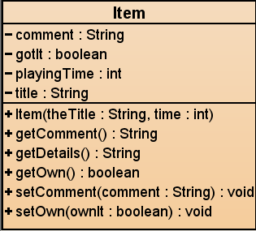
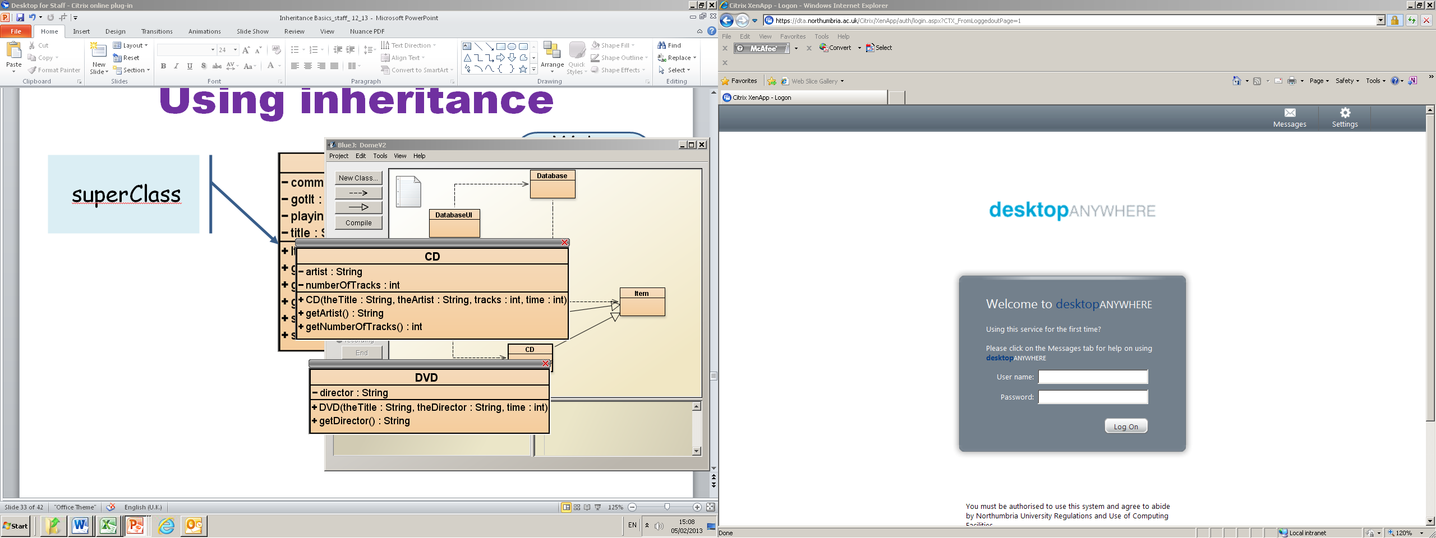
Using inheritance
We’ve placed the common attributes and methods in Item
superClass
Notes:
solution: inheritance. make superclass with common attributes, make subclasses

Slide 36
superClass
public class Item
{
// attributes common to subclasses
private String title;
private int playingTime;
private boolean gotIt;
private String comment;
// constructors and methods omitted.
}
Notes:
we define common fields in superclass

Slide 37
Subclass Classes
public class CD extends Item
{
private String artist;
private int numberOfTracks;
// constructors and methods omitted.
}
public class DVD extends Item
{
private String director;
// constructors and methods omitted.
}
Notes:
we add subclass fields; inherit superclass fields (note extends keyword)
subclass objects will have all fields.

Slide 38
Inheritance and constructors
public class Item
{
…
/**
* Initialise the fields of the item.
*/
public Item (String theTitle, int time)
{
title = theTitle;
playingTime = time;
gotIt = false;
comment = "";
}
// methods omitted
}
Notes:
how do we initialise the fields? superclass: nothing unusual.

Slide 39
Inheritance and constructors
public class CD extends Item
{
private String artist;
private int numberOfTracks;
//Constructor for objects of class CD
public CD (String theTitle, String theArtist,
int tracks, int time)
{
super(theTitle, time);
artist = theArtist;
numberOfTracks = tracks;
}
// methods omitted
}
Notes:
subclass: must call superclass constructor! Must take values for all
fields that we want to initialise.

Slide 40
Exercise 5
Amend the constructer for CD as the previous slide and write the revised constructor for DVD.
(Remember without Item you can’t compile it). yet).

Slide 41
Exercise continued
Write the Item class (some code on slides 36 & 38).
Amend the CD and DVD classes

Slide 42
Item – the rest!
public void setComment(String comment) {
this.comment = comment;
}
public String getComment() {
return comment;
}
public void setOwn(boolean ownIt) {
gotIt = ownIt;
}
public boolean getOwn() {
return gotIt;
}
public String getDetails() {
String details = title + " (" + playingTime + " mins)";
if(gotIt) {
details = details + "*" + "\n";
} else {
details = details + "\n";
}
details = details + " " + comment + "\n";
return details;
}

Slide 43
New Database source code
public class Database {
private ArrayList<Item> items;
// Construct an empty Database.
public Database()
{
items = new ArrayList<Item>();
}
public void addItem( Item theItem )
{
items.add(theItem);
}
...
}
items / CD / DVD ???
how does this work?
Find out for next week
Copies of revised code will be available from blackboard.

